Slide 1

Phase II: Change Management Plans
Confidential
Company: insert company name
CEO: insert your own text
Senior Change Manager: insert your own text
Date: insert your own text
Version: insert your own text
Contact Email: insert your own text
Insert your own logo

Slide 2
Guide
You can use this deliverable directly for your own purposes. You simply need to insert your logo and adjust the slides based on the specificities of your organization.
Please note that this document also includes many slides with best practices, tutorials and real-life examples to help you adjust this deliverable based on the specificities of your organization. These slides have an orange rectangle in the top-right corner. You may decide to delete these slides as they are mainly there to help you fill in the rest of the deliverable. Before you do, copy and paste this document so you always have the original version in case you need it.

Slide 3



This deliverable will focus on the phase II of our change management 3-phase approach
Phase I: Define the Change Management Strategy
Phase II: Develop the Change Management Plans
Phase III: Implement, Track and Manage Progress
Company strategy
Required change to implement the strategy
Business roadmap
Company readiness for change
Structure and size of the change management team
Roles & responsibilities
Guiding principles
Change Lean Canvas
Change impact assessment
Change management objectives and levers (ADKAR Model)
Overarching change management plan
Communication plan
Sponsorship plan
Coaching plan
Training plan
Resistance management plan
Governance
Overarching change management plan status report
Communication plan status report
Sponsorship plan status report
Coaching plan status report
Training plan status report
Resistance management plan status report
Stakeholder management
Change reinforcement
Top 12 change management frameworks and tools commonly used in most Fortune 500 companies
Kotter’s 8 step Model of Change
McKinsey 7S framework
Burke-Litwin Change Model
Prosci 3-phase process
The Adkar Change Management Model
Lewin's Change Management Model
Change commitment curve
Change personal transition curve
Heart and mind human drivers
Innovation adoption curve
Maslow’s hierarchy of human needs
Four stages of team development

Slide 4
Table of contents
Phase I: Define the Change Management Strategy
Phase II: Develop the Change Management Plans
Phase III: Implement, Track and Manage Progress
Company strategy
Required change to implement the strategy
Business roadmap
Company readiness for change
Structure and size of the change management team
Roles & responsibilities
Guiding principles
Change Lean Canvas
Change impact assessment
Change management objectives and levers (ADKAR Model)
Overarching change management plan
Communication plan
Sponsorship plan
Coaching plan
Training plan
Resistance management plan
Governance
Overarching change management plan status report
Communication plan status report
Sponsorship plan status report
Coaching plan status report
Training plan status report
Resistance management plan status report
Stakeholder management
Change reinforcement
Top 12 change management frameworks and tools commonly used in most Fortune 500 companies
Kotter’s 8 step Model of Change
McKinsey 7S framework
Burke-Litwin Change Model
Prosci 3-phase process
The Adkar Change Management Model
Lewin's Change Management Model
Change commitment curve
Change personal transition curve
Heart and mind human drivers
Innovation adoption curve
Maslow’s hierarchy of human needs
Four stages of team development

Slide 5
Table of contents
Best practice
Phase I: Define the Change Management Strategy
Phase II: Develop the Change Management Plans
Phase III: Implement, Track and Manage Progress
Company strategy
Required change to implement the strategy
Business roadmap
Company readiness for change
Structure and size of the change management team
Roles & responsibilities
Guiding principles
Change Lean Canvas
Change impact assessment
Change management objectives and levers (ADKAR Model)
Overarching change management plan
Communication plan
Sponsorship plan
Coaching plan
Training plan
Resistance management plan
Governance
Overarching change management plan status report
Communication plan status report
Sponsorship plan status report
Coaching plan status report
Training plan status report
Resistance management plan status report
Stakeholder management
Change reinforcement
For each plan, we suggest to have a one or two-page summary in Powerpoint and a more detailed version in Excel. The Powerpoint version is ideal when you present to the CEO or executive committee, who usually don’t have much time. The Excel version is ideal to “do the work” (as opposed to giving a high-level view of what’s going on to decision makers).
The Excel version of each plan was part of your purchase.
Top 12 change management frameworks and tools commonly used in most Fortune 500 companies
Kotter’s 8 step Model of Change
McKinsey 7S framework
Burke-Litwin Change Model
Prosci 3-phase process
The Adkar Change Management Model
Lewin's Change Management Model
Change commitment curve
Change personal transition curve
Heart and mind human drivers
Innovation adoption curve
Maslow’s hierarchy of human needs
Four stages of team development

Slide 6
Overarching Change Management Plan One-page summary
 | March | April | May | June | July | August | Sept | October
Understand the Company’s Strategy
Understand the Change required to implement the Strategy
Define your Change Management Strategy
Identify the Impact of the Change
Develop a Communication Plan
Develop a Sponsorship Plan
Develop a Coaching Plan
Develop a Training Plan
Develop a Resistance Management Plan
Implement, Track & Manage Progress
Reinforce the Change

Slide 7
Overarching Change Management Plan One-page summary
Best practice
 | March | April | May | June | July | August | Sept | October
Understand the Company’s Strategy
Understand the Change required to implement the Strategy
Define your Change Management Strategy
Identify the Impact of the Change
Develop a Communication Plan
Develop a Sponsorship Plan
Develop a Coaching Plan
Develop a Training Plan
Develop a Resistance Management Plan
Implement, Track & Manage Progress
Reinforce the Change
Try to make it as simple as possible. What is too complex is usually never implemented
The next slides will provide you some additional Plan templates. Pick up the one that best suits your needs.

Slide 8
Project Plans, Timelines & Gantt Charts
Additional template
Split by Month
2017
January | Feb | March | April | May | June | July | August | September | October | November | December
Phase 1
Milestone 1
Milestone 2
Phase 2
Milestone 3
Milestone 4
Phase 3
Milestone 5
Milestone 6

Slide 9
Project Plans, Timelines & Gantt Charts
Additional template
Split by weeks
2020 |  |  |  |  |  |  |  |  |  |  | 2021
21/10 | 27/10 | 03/11 | 10/11 | 17/11 | 24/11 | 01/12 | 8/12 | 15/12 | 22/12 | 29/12 | 05/01 | 12/01 | 19/01 | 26/01
Phase 1
Milestone 1
Milestone 2
Phase 2
Milestone 3
Milestone 4
Phase 3
Milestone 5
Milestone 6

Slide 10
Project Plans, Timelines & Gantt Charts
Additional template
Split by days
November
6 | 7 | 8 | 9 | 10 | 11 | 12 | 13 | 14 | 15 | 16 | 17 | 18 | 19 | 20 | 21 | 22 | 23 | 24 | 25 | 26 | 27 | 28 | 29
Phase I
Phase II
Phase III

Slide 11
Project Plans, Timelines & Gantt Charts
Additional template
Insert name
Key:
Insert name
Insert name
 | March | April | May | June | July | August | Sept | October
Insert name
Insert name
Insert name
Insert name
Insert name
Insert name
Insert name

Slide 12
Project Plans, Timelines & Gantt Charts
Additional template
Week | 1 | 2 | 3 | 4 | 5 | 6 | 7 | 8 | 9 | 10 | 11
Starts on | 7/1 | 14/1 | … | … | … | … | … | … | … | … | …
Phase 1
1.1 Activity
1.2 Activity
1.3 Activity
Phase 2
2.1 Activity
2.2 Activity
Phase 3
3.1 Activity
3.2 Activity
3.3 Activity
To add a column or a row, select a column or a row, click right and select “Insert”
Use Distribute Columns Evenly and Distribute Rows Evenly in Layout ribbon to keep columns and rows equal in width

Slide 13
Project Plans, Timelines & Gantt Charts
Additional template
Week | 1 | 2 | 3 | 4 | 5 | 6 | 7 | 8 | 9 | 10 | 11
Starts on | 7/1 | 14/1 | … | … | … | … | … | … | … | … | …
Phase 1
1.1 Activity
1.2 Activity
1.3 Activity
Phase 2
2.1 Activity
2.2 Activity
Phase 3
3.1 Activity
3.2 Activity
3.3 Activity
To add a column or a row, select a column or a row, click right and select “Insert”
Use Distribute Columns Evenly and Distribute Rows Evenly in Layout ribbon to keep columns and rows equal in width

Slide 14
Project Plans, Timelines & Gantt Charts
Additional template
January | February | March
Insert activity
Insert activity
Insert text
Insert activity
Insert activity
Insert activity
Insert activity
Insert text
Insert activity
Insert activity
Insert activity
Insert text
Insert activity

Slide 15
Project Plans, Timelines & Gantt Charts
Additional template
Insert your own text
Insert your own text
Design
Plan
Implement and Embed
Insert text
Insert your own text
Insert your own text
Insert your own text
1
Insert text
Insert your own text
Insert your own text
Insert your own text
2
Insert text
Insert your own text
Insert your own text
Insert your own text
3
Insert text
Insert your own text
Insert your own text
Insert your own text
4
Insert text
Insert your own text
Insert your own text
Insert your own text
5
Insert text
Insert your own text
Insert your own text
Insert your own text
6
Insert text
Insert your own text
Insert your own text
Insert your own text
7

Slide 16
Project Plans, Timelines & Gantt Charts
Additional template
Insert your own text
Insert your own text
Type of change
Jan - March
April - June
July - September
October - December
Insert your own text
Insert text
Insert text
Insert text
Insert text
Insert your own text
Insert text
Insert text
Insert text
Insert text
Insert your own text
Insert text
Insert text
Insert text
Insert text
Insert your own text
Insert text
Insert text
Insert text
Insert text
Insert your own text
Insert text
Insert text
Insert text
Insert text

Slide 17
Project Plans, Timelines & Gantt Charts
Additional template
Activities
Contributors
Insert your own text
Insert your own text
Insert your own text
Insert your own text
Insert your own text
Insert your own text
Insert your own text
Insert your own text
Insert your own text
Insert your own text
Insert your own text
Insert your own text

Slide 18
Project Plans, Timelines & Gantt Charts
Additional template
Stream of work
Target State component
Target State
Insert Target State component
Insert Target State component
Insert Target State component
Insert Target State component
Insert Target State component
Insert stream of work
✓
✓
✓
✓
✓
Insert stream of work
✓
✓
Insert stream of work
✓
✓
✓
Insert stream of work
✓
Insert stream of work
✓
✓
Insert stream of work
✓
✓
Insert stream of work
✓
✓
✓
Insert stream of work
✓
✓
✓
✓
✓

Slide 19
Project Plans, Timelines & Gantt Charts
Additional template
2020
Placeholder:
All phrases can be replaced by your own text / All phrases can be replaced by your own text
All phrases can be replaced by your own text / All phrases can be replaced by your own text
2021
Placeholder:
All phrases can be replaced by your own text / All phrases can be replaced by your own text
All phrases can be replaced by your own text / All phrases can be replaced by your own text
2022
Placeholder:
All phrases can be replaced by your own text / All phrases can be replaced by your own text
All phrases can be replaced by your own text / All phrases can be replaced by your own text
2023
Placeholder:
All phrases can be replaced by your own text / All phrases can be replaced by your own text
All phrases can be replaced by your own text / All phrases can be replaced by your own text
2024
Placeholder:
All phrases can be replaced by your own text / All phrases can be replaced by your own text
All phrases can be replaced by your own text / All phrases can be replaced by your own text

Slide 20
Project Plans, Timelines & Gantt Charts
Additional template
Key:
Insert text
Insert text
Insert text
Insert text
 | # of people | March | April | May | June | July | August
Insert team name | 15
Insert team name | 8
Insert team name | 10
Insert team name | 8
Insert team name | 19
Insert team name | 8
Insert team name | 14
Insert team name | 8
Insert team name | 50
Insert team name | 10
Insert team name | 51

Slide 21
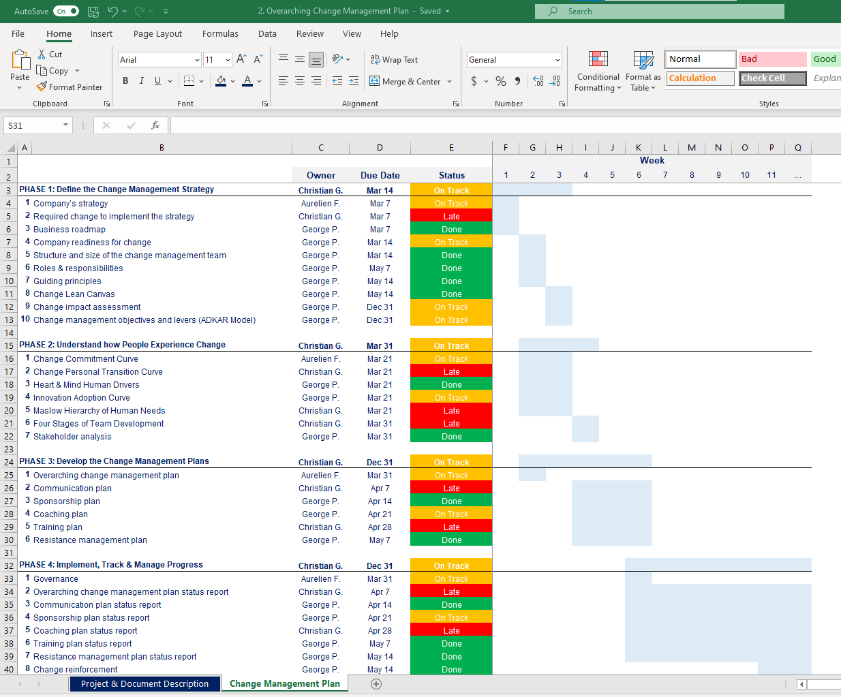
Overarching Change Management Plan Open the Excel document “Overarching Change Management Plan” for more details

Slide 22
Overarching Change Management Plan Open the Excel document “Overarching Change Management Plan” for more details
Best practice
Based on the specificities of your situation, you’ll have to customize the Excel version too.
When you present your deliverable to your hierarchy, keep the Excel version open on your computer, in case your audience wants to deep dive in the plan.

Slide 23
Table of contents
Phase I: Define the Change Management Strategy
Phase II: Develop the Change Management Plans
Phase III: Implement, Track and Manage Progress
Company strategy
Required change to implement the strategy
Business roadmap
Company readiness for change
Structure and size of the change management team
Roles & responsibilities
Guiding principles
Change Lean Canvas
Change impact assessment
Change management objectives and levers (ADKAR Model)
Overarching change management plan
Communication plan
Sponsorship plan
Coaching plan
Training plan
Resistance management plan
Governance
Overarching change management plan status report
Communication plan status report
Sponsorship plan status report
Coaching plan status report
Training plan status report
Resistance management plan status report
Stakeholder management
Change reinforcement
Top 12 change management frameworks and tools commonly used in most Fortune 500 companies
Kotter’s 8 step Model of Change
McKinsey 7S framework
Burke-Litwin Change Model
Prosci 3-phase process
The Adkar Change Management Model
Lewin's Change Management Model
Change commitment curve
Change personal transition curve
Heart and mind human drivers
Innovation adoption curve
Maslow’s hierarchy of human needs
Four stages of team development

Slide 24
Communication channel matrix The Channel Matrix below will give us a comprehensive list of the key communication channels to consider, from face-to-face meetings to newsletters.
Channels under direct control of management
Face-to-face options
Department or enterprise meetings
Group meetings
Focus groups
One-on-one meetings
Road show presentations (by project team)
Town Hall meetings
Team meetings
Brown bag lunches
Training courses and workshops
Alternate communication channels
Emails
Bulletin boards
Cafeteria postings
Change booklets
Corporate newsletters (feature section)
Demonstrations
Frequently asked questions (memos or newsletter feature)
Internal memos
Intranet pop-ups
Leaflets
Posters
Project newsletters
Videos
Voicemails
Webcasts
Website (Intranet)
Word of mouth
Channels not under direct control of management
Marketplace changes
Customer input
Ready-access to information
Employee rumors

Slide 25
Summary of our key stakeholder groups & messages
Stakeholder Group
Key Messages
Insert Stakeholder Group Name
Insert key message #1
Insert key message #2
Insert key message #3
Insert Stakeholder Group Name
Insert key message #1
Insert key message #2
Insert key message #3
Insert Stakeholder Group Name
Insert key message #1
Insert key message #2
Insert key message #3
Insert Stakeholder Group Name
Insert key message #1
Insert key message #2
Insert key message #3
Insert Stakeholder Group Name
Insert key message #1
Insert key message #2
Insert key message #3
Insert Stakeholder Group Name
Insert key message #1
Insert key message #2
Insert key message #3

Slide 26
Summary of our key stakeholder groups & messages
Tutorial
Stakeholder Group
Key Messages
Insert Stakeholder Group Name
Insert key message #1
Insert key message #2
Insert key message #3
Insert Messages about the business today (e.g. current situation; rationale for change; what might happen if the change does not make)
Insert Messages about the change (e.g. A vision of the organization after the change takes place; scope of the change; objective of the change; timeframe; alignment between the change and the Business strategy)
Insert Messages about how the change will impact employees (e.g. The impact of the change on the day-to-day activities of each employee; what’s in it for me from the employees’ perspective; Implications of the change on job security; Specific behaviors and activities expected from the employee; Procedures for getting help and assistance during the change; Ways to provide feedback)
Insert Messages about updates and progress reports (The schedule for the project overall; When will new information be available; How will information be shared about the project; Major milestones and deliverables; Key decision points; Early success stories)
Insert Stakeholder Group Name
Insert key message #1
Insert key message #2
Insert key message #3
Insert Stakeholder Group Name
Insert key message #1
Insert key message #2
Insert key message #3
Insert Stakeholder Group Name
Insert key message #1
Insert key message #2
Insert key message #3
Insert Stakeholder Group Name
Insert key message #1
Insert key message #2
Insert key message #3
Insert Stakeholder Group Name
Insert key message #1
Insert key message #2
Insert key message #3

Slide 27







Summary of our key stakeholder groups & communication channels
Stakeholder
Face to face
Forum
Email
Phone
Intranet
Training
Workshop
Relationship Owner
C-suite
Insert name
Senior Managers
Insert name
Managers
Insert name
Front line
Insert name
Managers
Insert name
Front line
Insert name

Slide 28
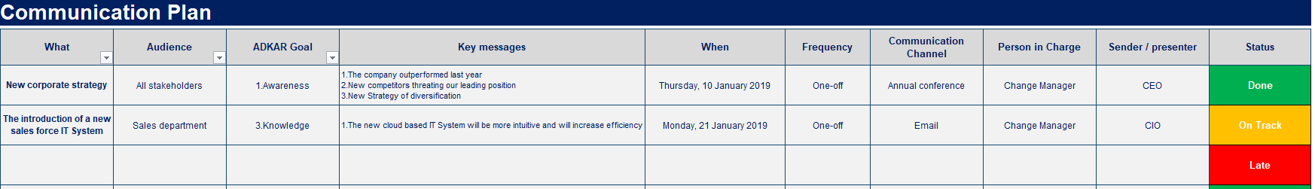
Communication Plan Open the Excel document “Communication Plan” for more details
This structured communication plan will help us present the right messages, at the right time, in the right format, and from the right sender.

Slide 29
Table of contents
Phase I: Define the Change Management Strategy
Phase II: Develop the Change Management Plans
Phase III: Implement, Track and Manage Progress
Company strategy
Required change to implement the strategy
Business roadmap
Company readiness for change
Structure and size of the change management team
Roles & responsibilities
Guiding principles
Change Lean Canvas
Change impact assessment
Change management objectives and levers (ADKAR Model)
Overarching change management plan
Communication plan
Sponsorship plan
Coaching plan
Training plan
Resistance management plan
Governance
Overarching change management plan status report
Communication plan status report
Sponsorship plan status report
Coaching plan status report
Training plan status report
Resistance management plan status report
Stakeholder management
Change reinforcement
Top 12 change management frameworks and tools commonly used in most Fortune 500 companies
Kotter’s 8 step Model of Change
McKinsey 7S framework
Burke-Litwin Change Model
Prosci 3-phase process
The Adkar Change Management Model
Lewin's Change Management Model
Change commitment curve
Change personal transition curve
Heart and mind human drivers
Innovation adoption curve
Maslow’s hierarchy of human needs
Four stages of team development

Slide 30
Summary of our key Sponsors and their Key Activities
Key Sponsors
Name of the change
Key Activities
Insert Sponsor Name
Insert the name of the change the Sponsor needs to focus on
Insert key activities #1
Insert key activities #2
Insert key activities #3
Insert Sponsor Name
Insert the name of the change the Sponsor needs to focus on
Insert key activities #1
Insert key activities #2
Insert key activities #3
Insert Sponsor Name
Insert the name of the change the Sponsor needs to focus on
Insert key activities #1
Insert key activities #2
Insert key activities #3
Insert Sponsor Name
Insert the name of the change the Sponsor needs to focus on
Insert key activities #1
Insert key activities #2
Insert key activities #3
Insert Sponsor Name
Insert the name of the change the Sponsor needs to focus on
Insert key activities #1
Insert key activities #2
Insert key activities #3
Insert Sponsor Name
Insert the name of the change the Sponsor needs to focus on
Insert key activities #1
Insert key activities #2
Insert key activities #3

Slide 31
Summary of our key Sponsors and their Key Activities
Tutorial
Key Sponsors
Name of the change
Key Activities
Insert Sponsor Name
Insert the name of the change the Sponsor needs to focus on
Insert key activities #1
Insert key activities #2
Insert key activities #3
Insert key activities that the Sponsor will have with:
The project team
The managers
The employees
Insert Sponsor Name
Insert the name of the change the Sponsor needs to focus on
Insert key activities #1
Insert key activities #2
Insert key activities #3
Insert Sponsor Name
Insert the name of the change the Sponsor needs to focus on
Insert key activities #1
Insert key activities #2
Insert key activities #3
Insert Sponsor Name
Insert the name of the change the Sponsor needs to focus on
Insert key activities #1
Insert key activities #2
Insert key activities #3
Insert Sponsor Name
Insert the name of the change the Sponsor needs to focus on
Insert key activities #1
Insert key activities #2
Insert key activities #3
Insert Sponsor Name
Insert the name of the change the Sponsor needs to focus on
Insert key activities #1
Insert key activities #2
Insert key activities #3

Slide 32
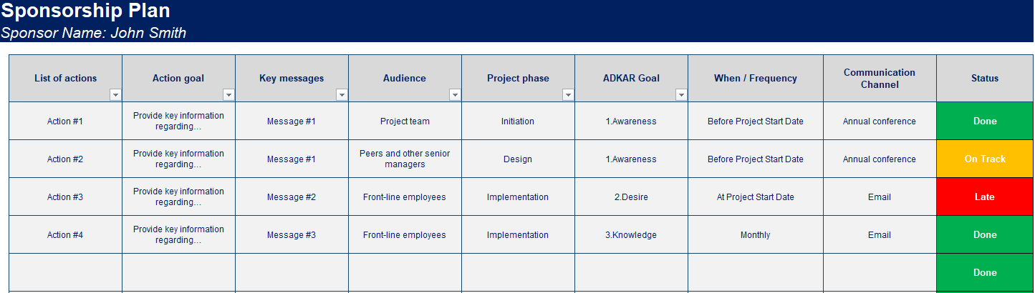
Sponsorship Plan Open the Excel document “Sponsorship Plan” for more details
This sponsorship plan will help us lay out what the sponsor needs to be doing with the project team and the different relevant stakeholders.

Slide 33
Sponsorship Plan Open the Excel document “Sponsorship Plan” for more details
Best practice
This sponsorship plan will help us lay out what the sponsor needs to be doing with the project team and the different relevant stakeholders.
Based on the specificities of your situation, you’ll have to customize the Excel version too.
When you present your deliverable to your hierarchy, keep the Excel version open on your computer, in case your audience wants to deep dive in the plan.

Slide 34
Table of contents
Phase I: Define the Change Management Strategy
Phase II: Develop the Change Management Plans
Phase III: Implement, Track and Manage Progress
Company strategy
Required change to implement the strategy
Business roadmap
Company readiness for change
Structure and size of the change management team
Roles & responsibilities
Guiding principles
Change Lean Canvas
Change impact assessment
Change management objectives and levers (ADKAR Model)
Overarching change management plan
Communication plan
Sponsorship plan
Coaching plan
Training plan
Resistance management plan
Governance
Overarching change management plan status report
Communication plan status report
Sponsorship plan status report
Coaching plan status report
Training plan status report
Resistance management plan status report
Stakeholder management
Change reinforcement
Top 12 change management frameworks and tools commonly used in most Fortune 500 companies
Kotter’s 8 step Model of Change
McKinsey 7S framework
Burke-Litwin Change Model
Prosci 3-phase process
The Adkar Change Management Model
Lewin's Change Management Model
Change commitment curve
Change personal transition curve
Heart and mind human drivers
Innovation adoption curve
Maslow’s hierarchy of human needs
Four stages of team development

Slide 35
Summary of the skills that will need to be coached
Skill to be coached
Coach Name
Audience
Insert the skill to be coached
Insert the Coach Name
Insert the name of the person or stakeholder group that need to be coached
Insert the name of the person or stakeholder group that need to be coached
Insert the name of the person or stakeholder group that need to be coached
Insert the skill to be coached
Insert the Coach Name
Insert the name of the person or stakeholder group that need to be coached
Insert the name of the person or stakeholder group that need to be coached
Insert the name of the person or stakeholder group that need to be coached
Insert the skill to be coached
Insert the Coach Name
Insert the name of the person or stakeholder group that need to be coached
Insert the name of the person or stakeholder group that need to be coached
Insert the name of the person or stakeholder group that need to be coached
Insert the skill to be coached
Insert the Coach Name
Insert the name of the person or stakeholder group that need to be coached
Insert the name of the person or stakeholder group that need to be coached
Insert the name of the person or stakeholder group that need to be coached
Insert the skill to be coached
Insert the Coach Name
Insert the name of the person or stakeholder group that need to be coached
Insert the name of the person or stakeholder group that need to be coached
Insert the name of the person or stakeholder group that need to be coached
Insert the skill to be coached
Insert the Coach Name
Insert the name of the person or stakeholder group that need to be coached
Insert the name of the person or stakeholder group that need to be coached
Insert the name of the person or stakeholder group that need to be coached

Slide 36
Coaching Plan One-page summary
 | March | April | May | June | July | August | Sept | October
Insert a key activity that you want to highlight
Insert a key activity that you want to highlight
Insert a key activity that you want to highlight
Insert a key activity that you want to highlight
Insert a key activity that you want to highlight
Insert a key activity that you want to highlight
Insert a key activity that you want to highlight
Insert a key activity that you want to highlight
Insert a key activity that you want to highlight
Insert a key activity that you want to highlight
Insert a key activity that you want to highlight

Slide 37
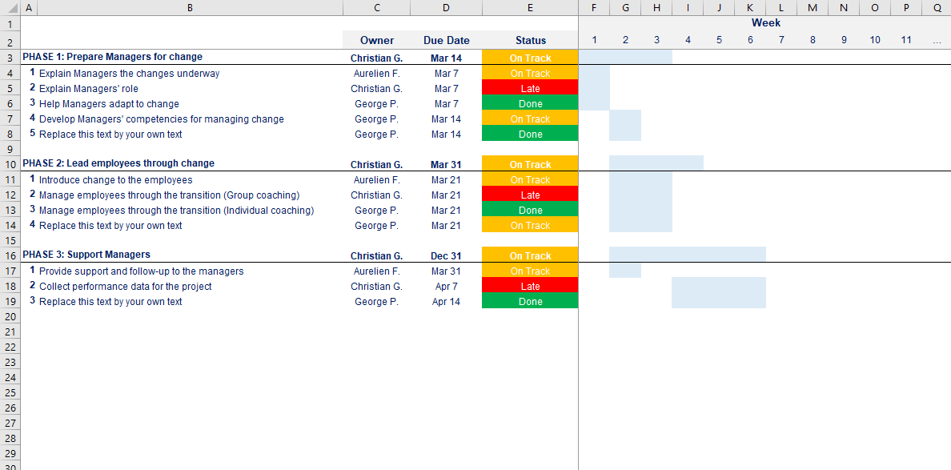
Coaching Plan Open the Excel document “Coaching Plan” for more details
This coaching plan will help you outline the steps for involving managers in change management activities.

Slide 38
Coaching Plan Open the Excel document “Coaching Plan” for more details
Best practice
This coaching plan will help you outline the steps for involving managers in change management activities.
Based on the specificities of your situation, you’ll have to customize the Excel version too.
When you present your deliverable to your hierarchy, keep the Excel version open on your computer, in case your audience wants to deep dive in the plan.

Slide 39
Table of contents
Phase I: Define the Change Management Strategy
Phase II: Develop the Change Management Plans
Phase III: Implement, Track and Manage Progress
Company strategy
Required change to implement the strategy
Business roadmap
Company readiness for change
Structure and size of the change management team
Roles & responsibilities
Guiding principles
Change Lean Canvas
Change impact assessment
Change management objectives and levers (ADKAR Model)
Overarching change management plan
Communication plan
Sponsorship plan
Coaching plan
Training plan
Resistance management plan
Governance
Overarching change management plan status report
Communication plan status report
Sponsorship plan status report
Coaching plan status report
Training plan status report
Resistance management plan status report
Stakeholder management
Change reinforcement
Top 12 change management frameworks and tools commonly used in most Fortune 500 companies
Kotter’s 8 step Model of Change
McKinsey 7S framework
Burke-Litwin Change Model
Prosci 3-phase process
The Adkar Change Management Model
Lewin's Change Management Model
Change commitment curve
Change personal transition curve
Heart and mind human drivers
Innovation adoption curve
Maslow’s hierarchy of human needs
Four stages of team development

Slide 40
Summary of the key Training that will need to be done
Key Training
Delivery Channel
Audience
Insert Training Name
Insert the name of the change the Sponsor needs to focus on
Insert key action #1
Insert key action #2
Insert key action #3
Insert Training Name
Insert the name of the change the Sponsor needs to focus on
Insert key action #1
Insert key action #2
Insert key action #3
Insert Training Name
Insert the name of the change the Sponsor needs to focus on
Insert key action #1
Insert key action #2
Insert key action #3
Insert Training Name
Insert the name of the change the Sponsor needs to focus on
Insert key action #1
Insert key action #2
Insert key action #3
Insert Training Name
Insert the name of the change the Sponsor needs to focus on
Insert key action #1
Insert key action #2
Insert key action #3
Insert Training Name
Insert the name of the change the Sponsor needs to focus on
Insert key action #1
Insert key action #2
Insert key action #3

Slide 41
Training Plan One-page summary
 | March | April | May | June | July | August | Sept | October
Insert a key activity that you want to highlight
Insert a key activity that you want to highlight
Insert a key activity that you want to highlight
Insert a key activity that you want to highlight
Insert a key activity that you want to highlight
Insert a key activity that you want to highlight
Insert a key activity that you want to highlight
Insert a key activity that you want to highlight
Insert a key activity that you want to highlight
Insert a key activity that you want to highlight
Insert a key activity that you want to highlight

Slide 42
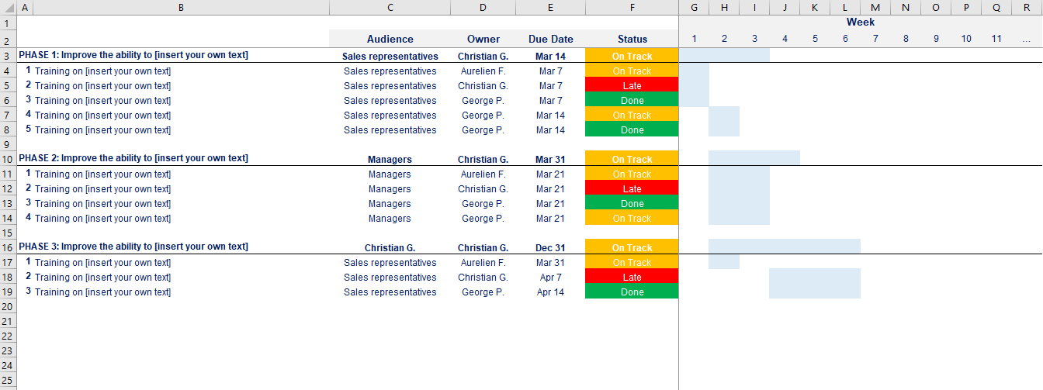
Training Plan Open the Excel document “Training Plan” for more details
This training plan will help us build the skills and capabilities required to successfully implement the change.

Slide 43
Training Plan Open the Excel document “Training Plan” for more details
Best practice
This training plan will help us build the skills and capabilities required to successfully implement the change.
Based on the specificities of your situation, you’ll have to customize the Excel version too.
When you present your deliverable to your hierarchy, keep the Excel version open on your computer, in case your audience wants to deep dive in the plan.

Slide 44
Table of contents
Phase I: Define the Change Management Strategy
Phase II: Develop the Change Management Plans
Phase III: Implement, Track and Manage Progress
Company strategy
Required change to implement the strategy
Business roadmap
Company readiness for change
Structure and size of the change management team
Roles & responsibilities
Guiding principles
Change Lean Canvas
Change impact assessment
Change management objectives and levers (ADKAR Model)
Overarching change management plan
Communication plan
Sponsorship plan
Coaching plan
Training plan
Resistance management plan
Governance
Overarching change management plan status report
Communication plan status report
Sponsorship plan status report
Coaching plan status report
Training plan status report
Resistance management plan status report
Stakeholder management
Change reinforcement
Top 12 change management frameworks and tools commonly used in most Fortune 500 companies
Kotter’s 8 step Model of Change
McKinsey 7S framework
Burke-Litwin Change Model
Prosci 3-phase process
The Adkar Change Management Model
Lewin's Change Management Model
Change commitment curve
Change personal transition curve
Heart and mind human drivers
Innovation adoption curve
Maslow’s hierarchy of human needs
Four stages of team development

Slide 45
Summary of the types of resistance to be expected
Type of resistance to be expected
Mitigation Action
Insert the type of resistance to be expected
Insert key action #1
Insert key action #2
Insert key action #3
Insert the type of resistance to be expected
Insert key action #1
Insert key action #2
Insert key action #3
Insert the type of resistance to be expected
Insert key action #1
Insert key action #2
Insert key action #3
Insert the type of resistance to be expected
Insert key action #1
Insert key action #2
Insert key action #3
Insert the type of resistance to be expected
Insert key action #1
Insert key action #2
Insert key action #3
Insert the type of resistance to be expected
Insert key action #1
Insert key action #2
Insert key action #3

Slide 46
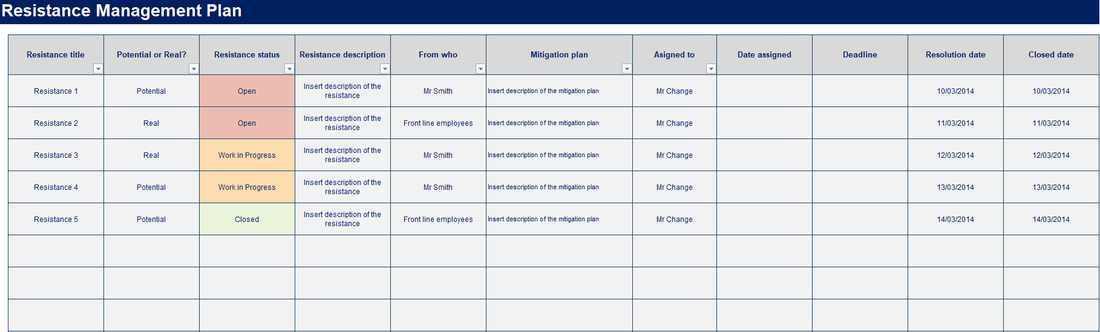
Resistance Management Plan Open the Excel document “Resistance Management Plan” for more details
The resistance management plan will help you identify which actions you can take to prevent potential or real resistance.

Slide 47
Resistance Management Plan Open the Excel document “Resistance Management Plan” for more details
Best practice
The resistance management plan will help you identify which actions you can take to prevent potential or real resistance.
Based on the specificities of your situation, you’ll have to customize the Excel version too.
When you present your deliverable to your hierarchy, keep the Excel version open on your computer, in case your audience wants to deep dive in the plan.

Slide 48
Example of actions to create the desire to change (1/2)
Tutorial to help you define your plans
Action title
Action description
Comment
Listen and understand objections
Listen with empathy and understand the objections of the employees. In many situation, employees just want to be heard and to voice their objections
Provide clarity if misunderstandings
Avoid debating or arguing with employees
Focus on the "what" and let go of the "how"
Communicate the “what” needs to be change without providing information on the “how”
Transfer ownership of the “how” to the employees. Employee involvement and ownership will naturally build desire for change
This action is useful in small groups and departments in which the change has little or no impact on other groups
Remove barriers
Understand the personal situation of each employee in order to identify potential barriers
Find solutions to address these barriers
Barriers could be family issues, health or money
Provide simple, clear choices and consequences
Communicate in simple and clear terms what the choices and consequences are for each employee
Providing clear choices and their consequences put the control back into the hands of employees
Create hope
Create desire to change by sharing your hope that the future will be better both for employees and the organization
The executive must have excellent leadership skills to create hope among employees
Source: Prosci

Slide 49
Example of actions to create the desire to change (2/2)
Tutorial to help you define your plans
Action title
Action description
Comment
Show the benefits in a real and tangible way
Share case studies of similar companies who have successfully competed a similar change
Invite guests to provide personal testimonials
Demonstrate the success of pilot program within you own organization
Making the change real and demonstrating that success is possible can remove doubts and fears that some employees feel about change
Make a personal appeal
Use a personal appeal such as “I believe in this change”, “It is important to me” or “I want your support”,
A personal appeal must come from a trusted and respected manager
Convert the strongest dissenters
Use special tactics and interventions to convert the strongest dissenters. By doing so, the strongest dissenters can become your strongest advocates
If you are not successful in converting the strongest dissenters, then the next action may be a viable option
Create a sacrifice
(After other actions have failed)
Send a powerful signal to the organization as a whole by removing a key manager that is demonstrating resistance to change
Target a “Group 3” employee that was supposed to leave the organization soon anyway
Try to create a win-win situation where you send a powerful message to the organization and the manager who is leaving gets a good termination package
Use money or power
(After other actions have failed)
If a senior manager is resistant to the change but critical of the success of the change, you can give him an incentive (e.g. bonus program, new position) on the successful completion of the change
It is important to assess what the manager’s contribution to the change is worth to the business
Source: Prosci

Slide 50
What are the key questions people ask in a period of change?
Tutorial to help you define your plans
Will my uniform remain the same?
Can I keep my job title?
Do I get to sit next to the same people?
What will change about my brand?
Will I get my Christmas Hamper?

Slide 51

What a leader needs to do to ensure positive cultural change?
Tutorial to help you define your plans
How leaders engage their teams and support their people through this period of change will form our Cultural Fabric. What you do, where you spend your time and what you pay attention to will be what starts to shape the culture of your team.
Back to basics:
Be active and visible
Think about where you invest your time and energy and what you pay attention to – and the message this sends
Be inclusive – involve people in your thinking
Make people your priority & balance this with purposeful work
Collaborate with one another, problem solve together – otherwise this will result in silos and people working against one another

Slide 52
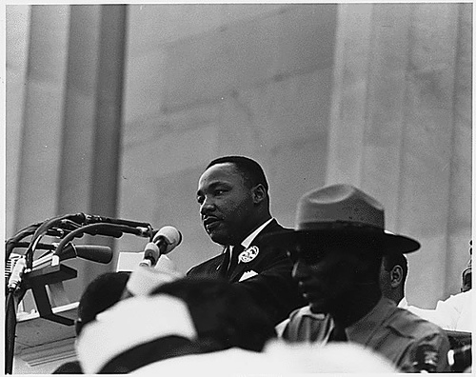
What was the catch line of Martin Luther King? What did he use these specific words?
Tutorial to help you define your plans
Martin Luther King did not say, “I have a very good plan,” he shouted, “I have a dream!”
You must provide passion, a strong sense of purpose and belief in the change you are leading.
- What can you focus on? How will you lead the changes facing you and/or your people?
- Which is more compelling: “We have a great new structure to support our transformation” or “We’re going to become New Zealand’s insurer of choice”?
- Remember: Steve Jobs didn't sell phones he sold dreams.

Slide 53
How would you create awareness of the need for change?
Tutorial to help you define your plans
The communicator is as important as the message. This matrix below will help you to identify which communicator should communicate which message:
Message / Communicator matrix
Message Type
Communicator
Rationale
Messages about the business today
CEO or Senior Business Executive
Employees want to hear from the person at the highest possible level
Messages about the change
CEO or Senior Business Executive
Employees want to hear from the person at the highest possible level
Messages about how the change impacts employees
Direct Supervisor
Employees want to hear from their direct supervisor

Slide 54
What is the Knowledge Matrix?
Tutorial to help you define your plans
The knowledge matrix is a tool created by Prosci. It refers to the learning process which includes learning about the change and information about how to change. The Knowledge Matrix below will help you provide the right information using the right channel
Channel title
Channel description
Content
Training programs
Web-based online training
Formal class-room training
Presentations and / or discussions during staff meetings
A restatement of the business reasons for change
A detailed description of the future state
Description of the skills, knowledge and behaviors that are needed by employees to support the change
What to do when the new processes or tools do not work
Open and ready access to information
Electronic access through intranets
Shared file servers
Web pages
Physical access to a project room or project library
Bulletin boards
Workstations and Kiosks
Project schedules and milestones
New policies
Procedures and Process flowcharts and descriptions
New tools and software applications
New job descriptions and roles
Examples and role models
Hands-on demonstration
Help from employees that are further along in the learning curve
Example on how to properly use new skills
Example on how to use a new tool
Example on how follow the new processes

Slide 55
What is the Ability Matrix?
Tutorial to help you define your plans
The ability matrix is a tool created by Prosci that will help you to transfer knowledge into abilities and counter common obstacles:
Type of ability
Ability description
Common obstacles
Change manager role
Physical ability
Develop new or different physical abilities such as carrying products, driving a heavy vehicle or writing on a keyboard
Individual: strength, coordination, size, disabilities, medical conditions
Environmental: space limitations, external constraints
Ensure that coaches, supervisors, team leaders and early adopters of change are prepared to assist employees through the "learning curve" of developing ability
Diagnose the main obstacles or root causes of the problem to developing ability for your change
Plan, implement the intervention (e.g. oversight, individual counselling, etc.) to address the main obstacles or root causes of the problem, and assess the results
Analytical or cognitive ability
Develop new or different analytical or cognitive ability such as problem-solving, public speaking or marketing skills
Mental: experience, intellect, memory
Psychological blocks: past history, fear of failure
Behavioral ability
Develop new or different behavioral abilities such interpersonal relationships, management or listening skills
Habits and addictions
Underlying values and belief systems

Slide 56
Time now to focus on the Phase III, located in the folder “Phase III - Implement, Track & Manage Progress”
Phase I: Define the Change Management Strategy
Phase II: Develop the Change Management Plans
Phase III: Implement, Track and Manage Progress
Company strategy
Required change to implement the strategy
Business roadmap
Company readiness for change
Structure and size of the change management team
Roles & responsibilities
Guiding principles
Change Lean Canvas
Change impact assessment
Change management objectives and levers (ADKAR Model)
Overarching change management plan
Communication plan
Sponsorship plan
Coaching plan
Training plan
Resistance management plan
Governance
Overarching change management plan status report
Communication plan status report
Sponsorship plan status report
Coaching plan status report
Training plan status report
Resistance management plan status report
Stakeholder management
Change reinforcement
Top 12 change management frameworks and tools commonly used in most Fortune 500 companies
Kotter’s 8 step Model of Change
McKinsey 7S framework
Burke-Litwin Change Model
Prosci 3-phase process
The Adkar Change Management Model
Lewin's Change Management Model
Change commitment curve
Change personal transition curve
Heart and mind human drivers
Innovation adoption curve
Maslow’s hierarchy of human needs
Four stages of team development

Slide 57
Thanks for your attention!
www.domontconsulting.com

